Slide 1
QHSUA’s
Young Adult Survey and
Parent of Young Adult Surveys: Overview and Results
Maegan Boutot, MS, QHSUA Epidemiologist

Slide 2
Approach
YAS
PYAS
Survey people 19-26 years old from QHSUA region
Use Facebook and Instagram ads
Use flyers around the QHSUA region
Available in English/Spanish
Survey the parents/former guardians of people 19-26 years old from QHSUA region
Use Facebook and Instagram ads
Use flyers around the QHSUA region

Slide 3
Response – Outreach efforts
October-November - Postcards
  Postcards to everyone with Ware zipcode
  3 responses total
January – Facebook posting in FB town groups
  Sessions on website: 24
February – Targeted ads + FB posting
  Ad targeted towards 19-50 year olds in the Quaboag Hills
  Impressions on FB: 42,541
  Link clicks on FB: 109
  Sessions on website: 15
March
  Clicks on FB ads: 226
  Impressions on FB ads: 85,100
  Sessions on website: 16
April – closed survey on the 6th
Demographic Breakdown (based on who's clicked on the ad):
  1. Males, 25-34
  2. Females, 25-34
  3. Females, 35-44
  4. Males, 35-44

Slide 4
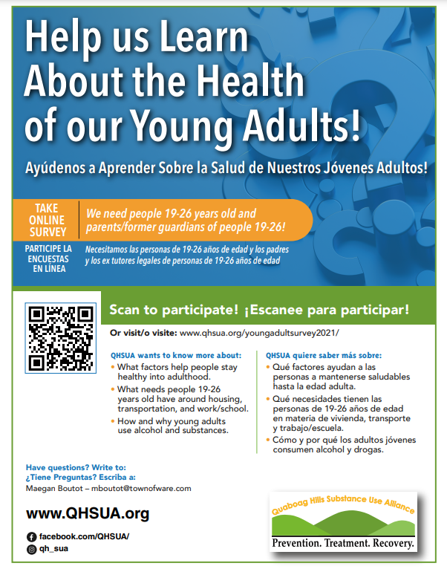

Slide 5
Responses for analysis
YAS, English: 20 start, 12 informative
YAS, Spanish: 1 start, 0 informative
PYAS, English: 17 start, 11 informative
PYAS, Spanish: 0 start, 0 informative

Slide 6
Results – YAS

Slide 7
Things to keep in mind
Self-enrollment
Small sample size – 12 total
11 / 12 participants 21-26 years old
Majority cis-women

Slide 8
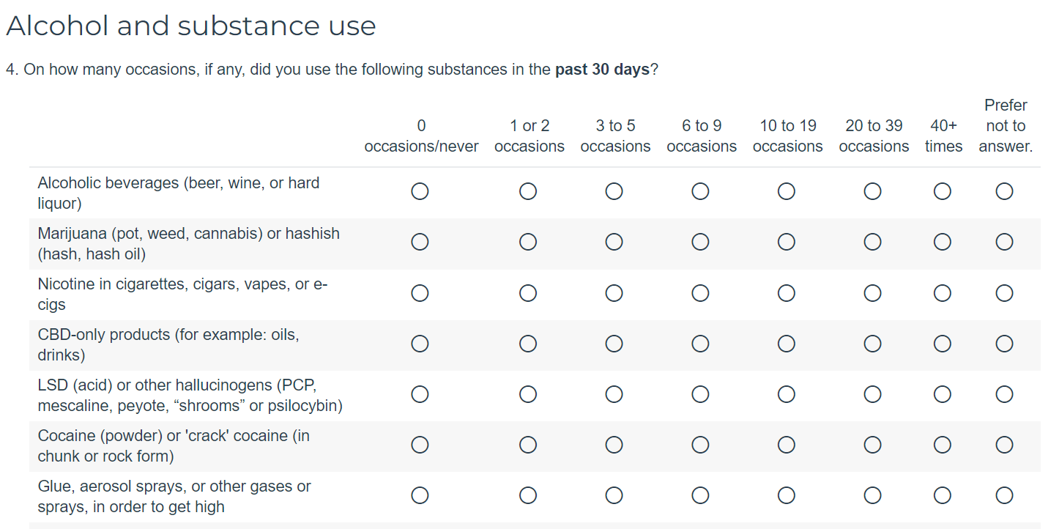

Slide 9
Notes:
All substances have been used – not a sample of people who are abstainers

Slide 10
Perceived Use
Now think about people 19-26 yo in your town. How many of them do you think [drank alcohol/used cannabis/etc.] sometime in the past 30 days?
Think of the “average person” 19-26 yo. How would you describe their [alcohol use/cannabis use/etc] relative to your use?
  None, 0%
  Few, 1-10%
  Some, 11-30%
  Some to half, 31-50%
  Half to most, 51-70%
  Most, 71-90%
  Almost all, 91-100%
0, prefer not to answer
1, far less
2, less
3, same amount
4, more
5, far more

Slide 12
Notes:
Vape and e-cigarette use is probably an underestimate

Slide 17
Results – PYAS

Slide 18
Things to keep in mind
Self-enrollment
Small sample size – 11 total
10/11 participants 45+
Number of children 19-26:
  Range 1-10 children
  Most common answer: 1 child
Most were not living with their children in this age range
7 out of 11 participants had children 19-20 years old
Could skip any question

Slide 19
Questions asked to parents/FG about substance use
Community use
Their own children’s use
Think about all people 19-26 years old in your town. How many of them do you think drank alcohol sometime in the past 30 days?
Are you concerned about the alcohol use of all people 19-26 years-old in your community?
Are you concerned about unsafe opioid use of all people 19-26 years-old in your community? Opioid use includes using heroin, using fentanyl, or using prescription opiates in a way not prescribed by a doctor.
Are there any other substances - such as LSD, cocaine, synthetic marijuana - that you think many people age 19-26 are using?
Do any of your children age 19-26 years old drink alcohol (beer, wine, spirits)?
Do you worry about the amount of alcohol any of your children 19-26 years old drink?
Do any of your children use [list of substances, including LSD, Rx misuse, heroin]

Slide 21
Other substances parents/guardians reported their children using:
  LSD
  MDMA
  Heroin

Slide 22
So How Do These Data Compare?

Slide 23



Perception vs reported use
YA = Young adult
PYA = parent/former guardian of young adults
YA’s perception of alcohol use is higher than reported use
YA and PYA’s perception of cannabis use is higher than reported use
YA and PYA’s perception of vape/e-cig use is higher than reported use

Slide 24
Alcohol
In our study, the % of people using alcohol was:
  Higher than the CCIS
  Similar to the NSDUH
Notes:
The any is a composite variable

Slide 25
Marijuana
In our study, the % of people using marijuana was:
  Higher than the CCIS
  Higher than the NSDUH
Is CCIS an underestimate? Lower than 12th grader rates
Notes:
The any is a composite variable

Slide 26
Other substances
Vaping: Our study rates similar to MTF, lower than CCIS
CCIS vape rate seems low
Rx misuse: Our study rates higher than all other studies
Notes:
The any is a composite variable

Slide 27
Other services the community may need

Slide 28
Our community has strong networks!

Slide 29
There are some places for us to provide support

Slide 34
Any questions?

Slide 35
Extra Slides

Slide 36
Notes:
The any is a composite variable

Slide 37
Alcohol – Additional Qs
Think back over the last 30 days. How many times have you had five or more alcoholic drinks in a row?
  17% all participants
  29% among all people who consumed alcohol in past 30 days

