Slide 1
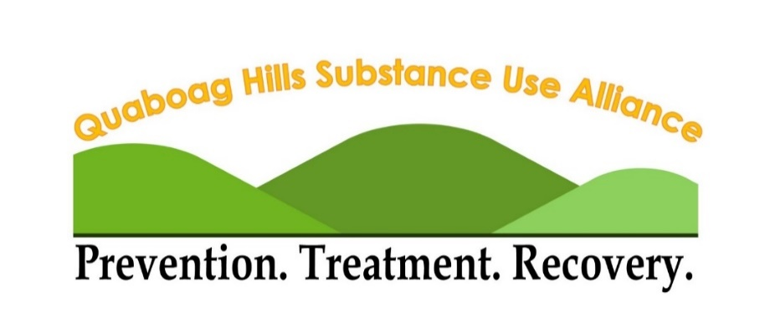
Prevention Needs Assessment Survey
2021
Funded by
Quaboag Hills Regionwide Results
Based on combined data from the following 6 school districts:
Belchertown, North Brookfield, Palmer, Quabbin Regional SD, Quaboag Regional SD and Ware

Slide 2
Who is included in the QHSUA report?

Slide 3
Why do we care about youth substance use?
We know now that the brain is still developing until age 25+
Early, heavy substance use can be a sign that youth and teens aren't getting the support they need.
We value every youth and want them to be healthy & happy adults
Public health science and research studies tell us that prevention works

Slide 4
Risk & Protective Factors at Multiple Levels
-Lack of support services
-Ease of availability to substances
-Norms supportive of substance use
-Opportunities for positive social involvement
-Laws and rules are consistently enforced
-Social services resources available.
Community
Individual
Family
School
-High quality education
-Climate of connectedness and belonging
-Relationships with educators is warm and supportive
-Poor quality education
-Limited experiences allowing connections
-Relationship with educators is disconnected
-Family conflict
-Any form of child abuse or neglect
-Caregiver with mental illness or substance abuse
-Stable home environment
-Supportive parenting
-Secure attachments to caregivers
-Clear rules and expectations
-Good social skills
-Good physical health
-Well developed cognitive skills
-Strong sense of self-worth
-Active engagement in activities
-Poor social skills
-Poorly developed coping responses
-Low self-esteem
-Poor peer relationships
-Mental illness

Slide 5
Substance Use Disorder
There are three factors that greatly increase the risks for someone to develop a Substance Use Disorder
Substance Use Disorder
Age of First Use
The earlier a individual initiates use, the greater the likelihood of creating dependency upon a substance. 90% of addictions begin in the teenage years.
Age of First Use
Family History of Addiction
Family History of Addiction
Individuals with a genetic link to family members with substance use disorder are more likely to develop an addiction. 1 in 2 youth with a family history who begin use in their teenage years are likely to develop an addiction.
Childhood Trauma
Childhood Trauma
Individuals with higher frequency or severity of adverse childhood experiences (ACEs) have a greater likelihood of developing a substance use disorder, as well as many other mental and physical health conditions.

Slide 6
Let’s take a moment to flip
that script…

Slide 7
There are three factors that greatly decrease the risks for someone to develop a Substance Use Disorder
Delayed First Use
Delayed use of substances is key. Those who wait until they are 21 years of age to use substances greatly reduce their likelihood of substance use disorder. 90% of addictions begin in the teenage years.
Family History of Addiction
Delayed First Use
Genetics is a predictive factor in substance use disorder, not a cause or a guarantee. Genetic factors contribute only 20-50% of the variance towards SUD, while non-genetic factors contribute the rest.
Family History of Addiction
Positive adult connections
Individuals with connections to caring adults, in a variety of parts of their lives, have far less likelihood of developing coping skills that include substance use.
Caring Adult Connections
Substance Use Disorder
Substance Use Disorder (SUD) is a chronic disease, that is caused by a combination of behavioral, psychological, environmental and biological factors.

Slide 8
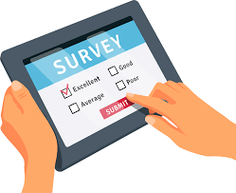
2021 Quaboag Hills Region-wide Prevention Needs Assessment Survey (PNAS)
Surveyed 8th, 10th, & 12th graders in 6 school districts
N =1,032
Surveying was conducted in schools in March-May 2021
Following info comes from a selection from the 50+ questions asked
Notes:
2019 data

Slide 9
How reliable is the data?
Honesty question
75% of students said they were "very honest" taking the survey
1% were excluded because they reported being dishonest or "only honest once in a while"
Results across remaining honesty levels are compared
We exclude surveys
that were <25% complete
with unrealistic levels alcohol and substance use
where students reported using a fake drug
where students reported high levels of antisocial behavior (e.g. attacking someone)
with inconsistencies

Slide 10
2021 Quaboag Hills Region-wide Parent Survey
Parents of Quaboag Hills schools, 6th-12th grade
N = ~ 130 parents
Parents invited to participate in the survey via Facebook, email, and through school letters/newsletters
Notes:
2019 data

Slide 11
#1 Take Away That We Want You To Know
Maybe you are not a data person and a ton of bar graphs and charts are just not your thing.
Maybe you had a horrible night sleep last night, and you just can’t stay awake for the next hour.
Maybe you really are Batman and the Bat signal calls you away.
It’s OK, we get it. But you really need to see this next slide- it’s important.

Slide 12
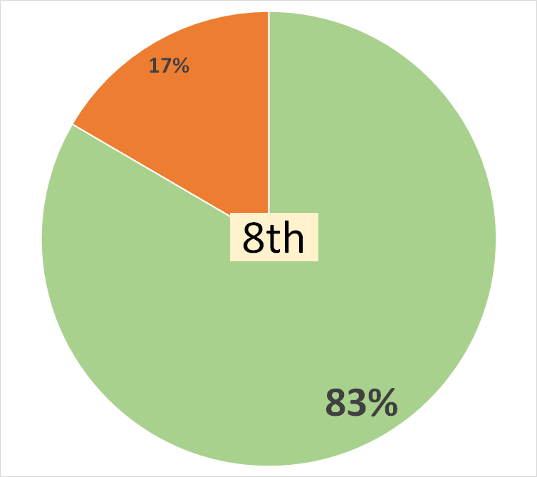
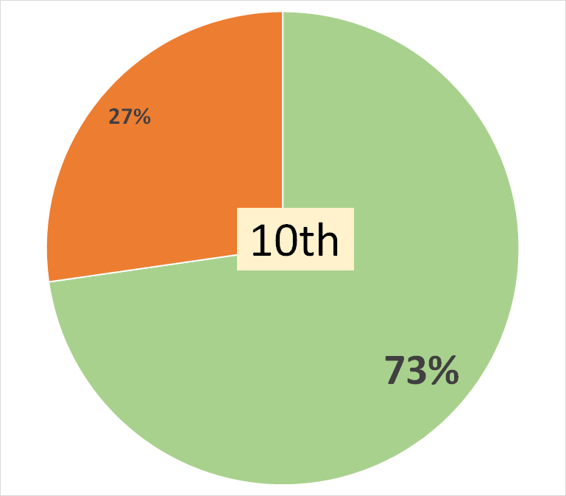
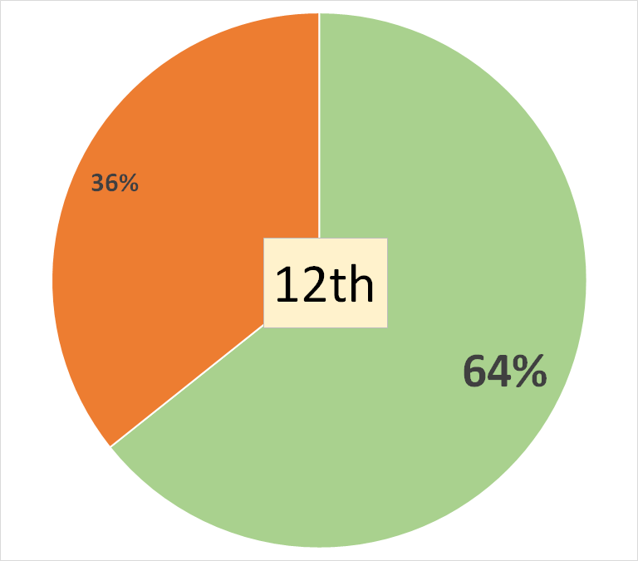
Most Students Didn't Use ANY Substance in the Past 30 Days!
12th grade excludes Quaboag Regional

Slide 13
Trend Analyses We now have enough data for trend analyses between 2017 and 2021!
As all good data people know, trend data requires matching collections. For this reason;
Palmer is excluded because there are no Palmer data for 2019
Quaboag is excluded from 12th grade analyses because there are no 12th grade data for 2021

Slide 14
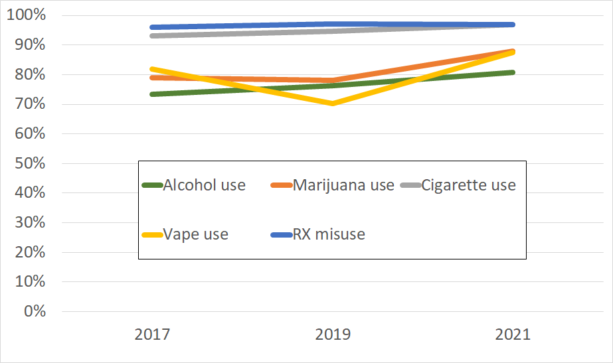
8-12th Graders NOT Using Substances 2017-2021 (excluding Palmer and Quaboag Regional)

Slide 15
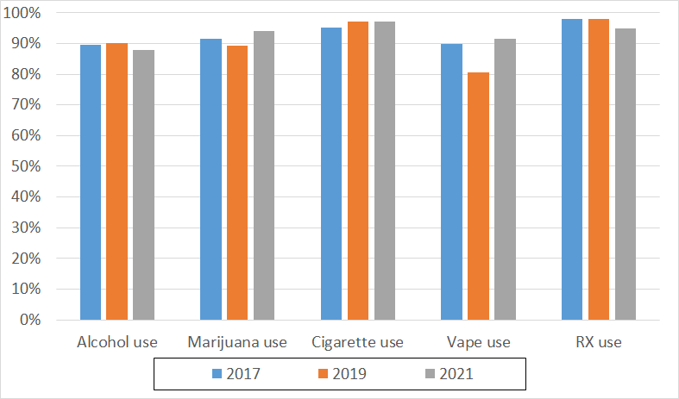
8th Graders NOT Using Substances, 2017-2021 (excluding Palmer)

Slide 16
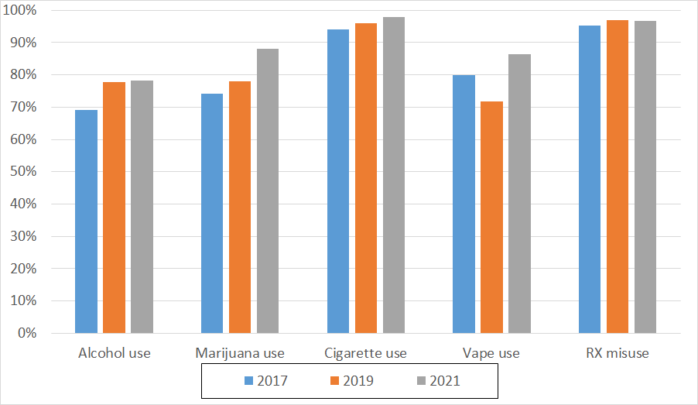
10th Graders NOT Using Substances, 2017-2021 (excluding Palmer)

Slide 17
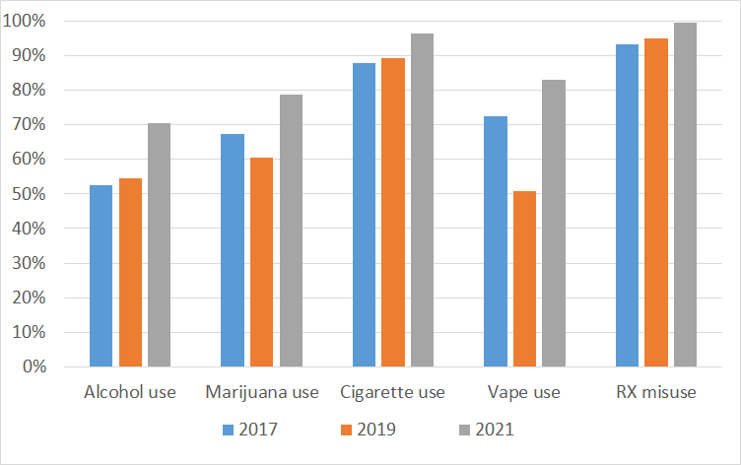
12th Graders NOT Using Substances, 2017-2021 (excluding Palmer + Quaboag Regional)

Slide 18
I Don’t Use Substances...
Reason | %
For my health | 88
To make my parents/guardians proud | 69
To follow the law | 64
To perform my best in sports, art, or school | 62
To be there for my friends | 56
To protect my reputation | 51
To be a positive role mode | 49
To make my teachers/coaches proud | 42

Slide 19
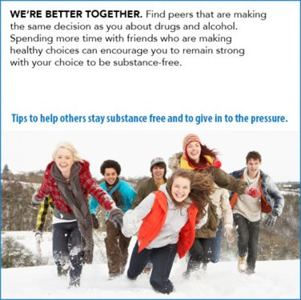
Most students think their friends do NOT approve of substance use!

Slide 20
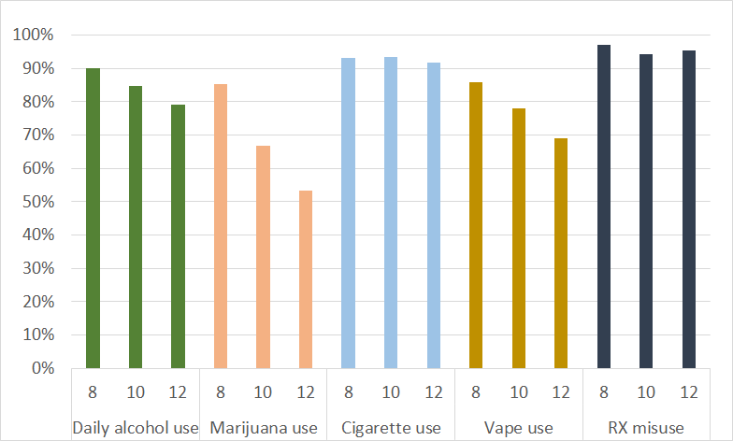
Percent of 2021 Students Who Report that Their Friends Think It's a Somewhat Wrong or Very Wrong For Them To Use Substances (Includes Palmer and Quaboag, except grade 12)

Slide 21
Percent of Students Who Report that Their Friends Think It's a Somewhat Wrong or Very Wrong For Them To Use Substances (Excludes Palmer and Quaboag grade 12)

Slide 22
We Are Targeting Efforts to Influence How Youth Perceive the Risks of Substance Use

Slide 23
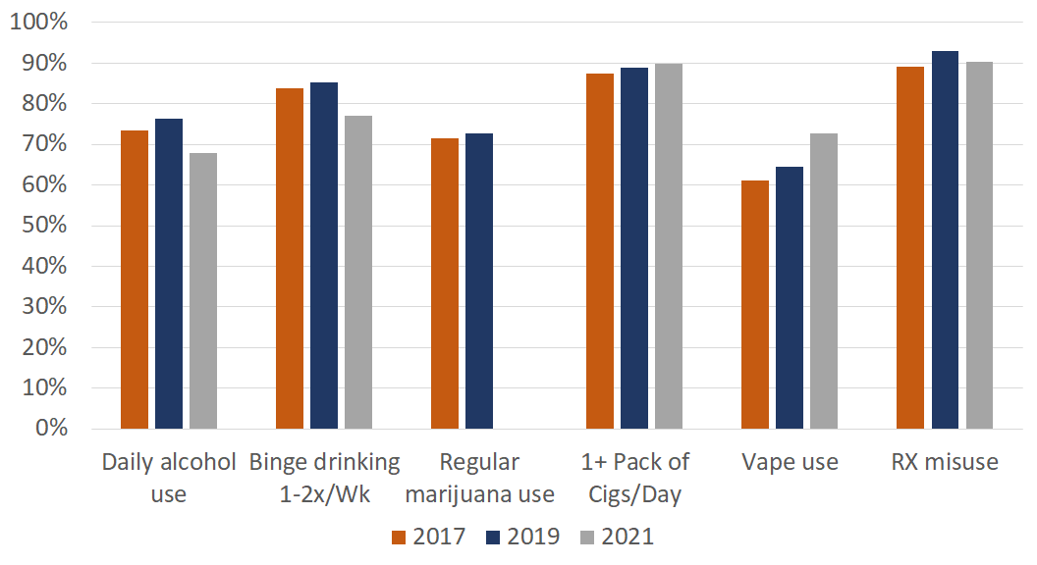
8th Graders Perceiving Substance Use as Moderate/Great Harm
There is no marijuana data for 2021*
Notes:
Binge drinking - How much do you think people risk harming themselves if they drink 5 or more drinks once or twice each week?

Slide 24
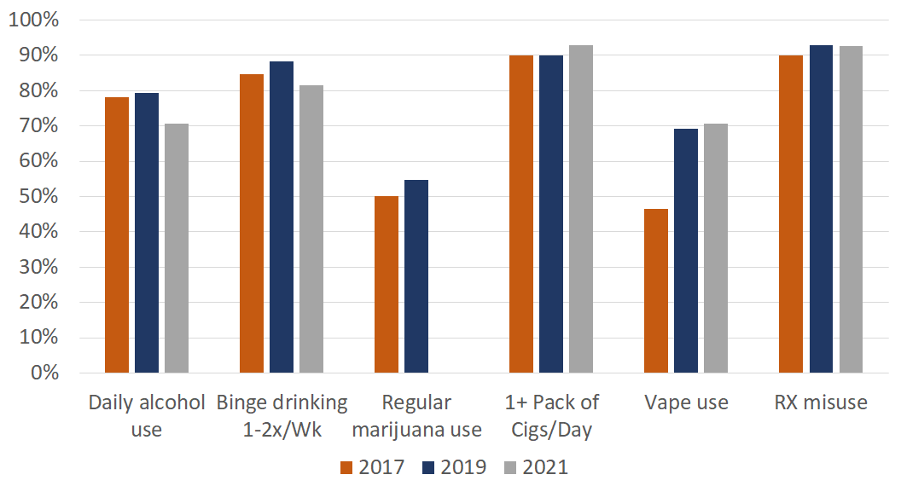
10th Graders Perceiving Substance Use as Moderate/Great Harm
There is no marijuana data for 2021*
Notes:
Binge drinking - How much do you think people risk harming themselves if they drink 5 or more drinks once or twice each week?

Slide 25
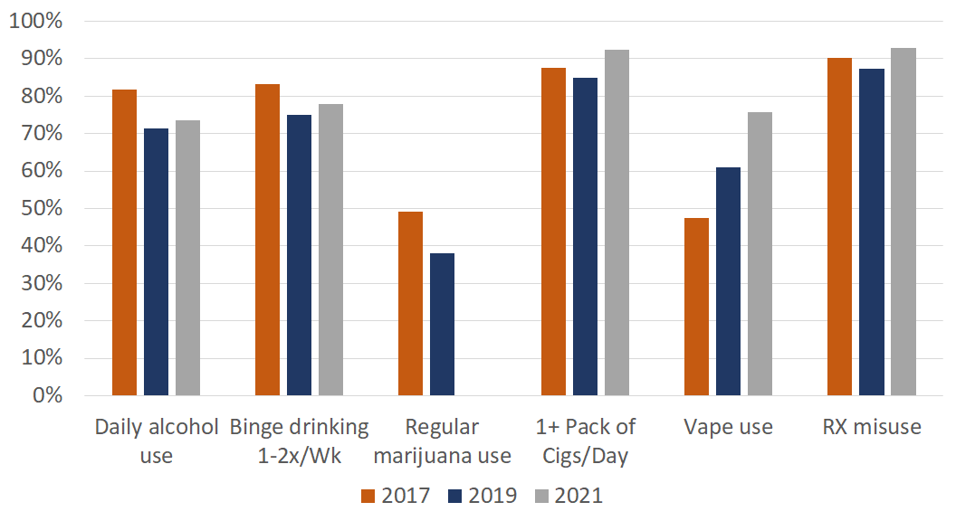
12th Graders Perceiving Substance Use as Moderate/Great Harm
There is no marijuana data for 2021*
Notes:
Binge drinking - How much do you think people risk harming themselves if they drink 5 or more drinks once or twice each week?

Slide 26
Substances Become Easier to Access as Youth Get Older But It Has Become Harder for All Ages to Access Vape Devices

Slide 27
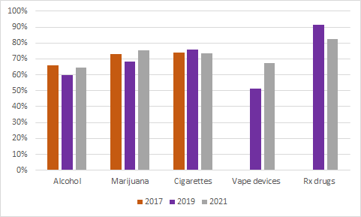
Percentage of 8th Graders Who Say It's Moderately/Very Difficult to Acquire Substances
There are no data for vape or RX substances from 2017*

Slide 28
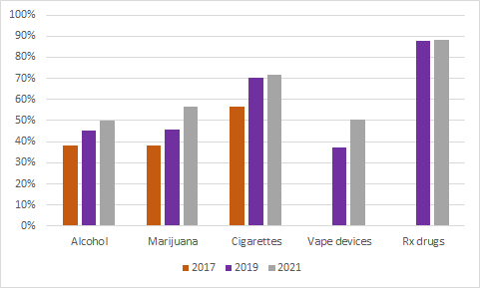
Percentage of 10th Graders Who Say It's Moderately/Very Difficult to Acquire Substances
There are no data for vape or RX substances from 2017*

Slide 29
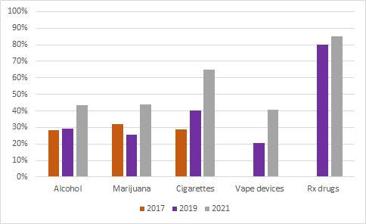
Percentage of 12th Graders Who Say It's Moderately/Very Difficult to Acquire Substances
There are no data for vape or RX substances from 2017*

Slide 30
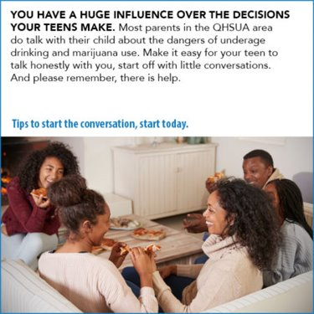
Most students think their parents do NOT approve of substance use!

Slide 31
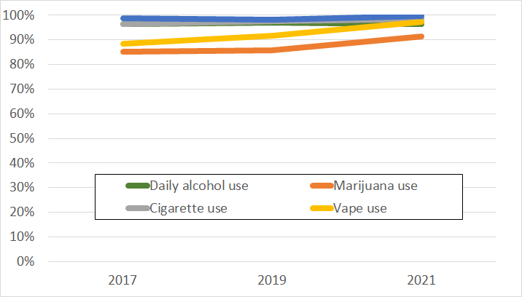
Percent of Students Who Report that Their Parents Think It's Somewhat Wrong or Very Wrong For Them To Use Substances (Excludes Palmer and Quaboag 12th graders

Slide 32
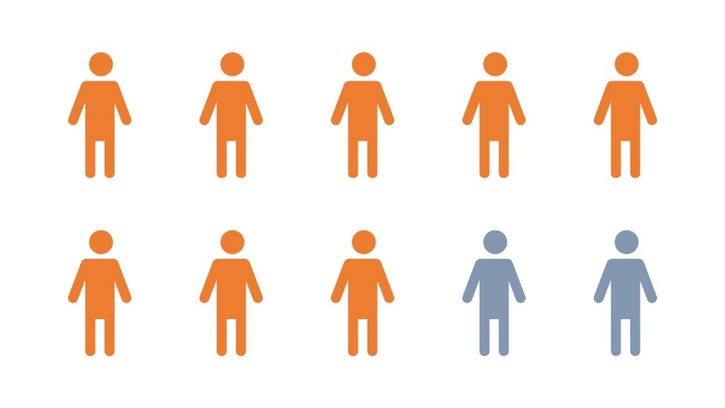
Substance use rules
More than 8 out of 10 Students Have Households with Clear Rules for Substance Use
Students who strongly agree that their parents/guardians have clear rules for substance use are
significantly less likely
to have used a substance in the 30 days prior to the survey.

Slide 33
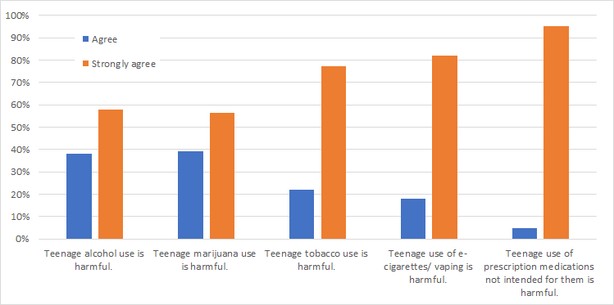
Parent Survey: How Parents Feel About Substance Use

Slide 34
But Where Do These Rules Come From?
Almost ALL households (~85%) have strong rules for substance use
BUT
Less than half (43%) of students
report having discussed substance use
with their parents/guardians in the last 12 months

Slide 35
It's probably worth talking to your kids regularly, even if you think there are strong rules in the house
Students who:
(1) spoke with parents about alcohol in the last 12 months
(2) AND perceived that their parents had strong rules about alcohol use
were 2.8 times less likely to use alcohol in the past 30 days*!
Students who:
(1) perceived that their parents had strong rules about alcohol use
(2) BUT who did not report speaking with parents about alcohol in the past 12 months were 2.5 times less likely to use alcohol in the past 30 days*
* compared to kids who neither perceived strong rules on alcohol use nor had conversations about alcohol use

Slide 36
Let’s look more closely at alcohol use

Slide 37
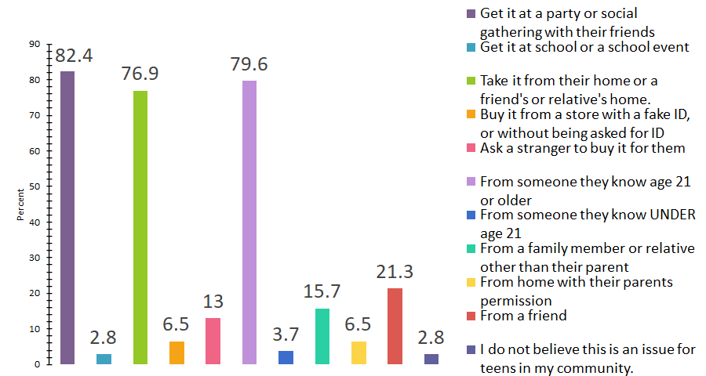
Parent survey: In your community, what do you think are the most common ways that teenagers get alcohol? Select up to 3 responses.

Slide 38
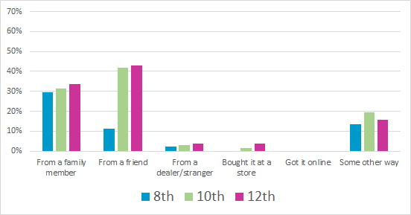
Where are students who used alcohol in the past 30 days getting alcohol from?

Slide 39
Do Parents Approve of Alcohol Use?
No! Of the 190 students who did drink alcohol in the past 30 days, 70% of them did so WITHOUT parent permission or knowledge
It was rare for parents to provide alcohol to teens (13 students total)
But be aware - this also means that you may not know if your child is using alcohol.
Notes:
--> BUT 10 of these 13 students reported that their parents disapproved of student daily alcohol use

Slide 40
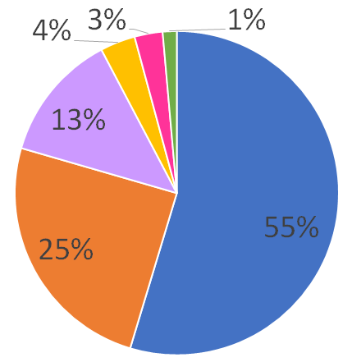
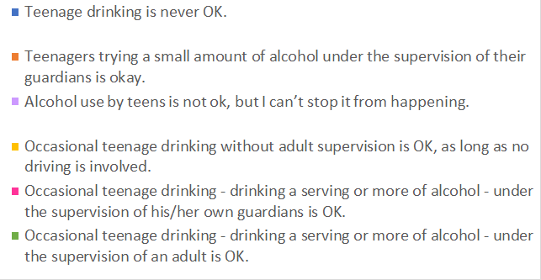
Parent Survey: Which of the following statements best represents your own beliefs about underage alcohol use?

Slide 41
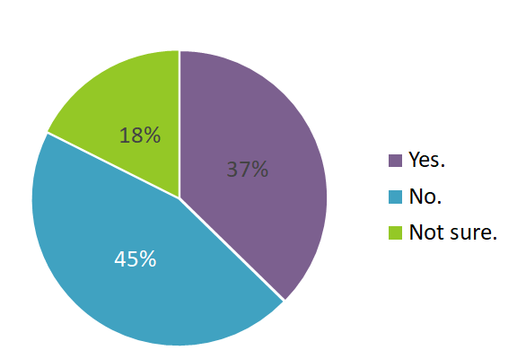
Parent Survey: Do you believe that teenage drinking is a "rite of passage" and that most teenagers drink alcohol at some point?

Slide 42
Let’s look more closely at vaping and marijuana

Slide 43
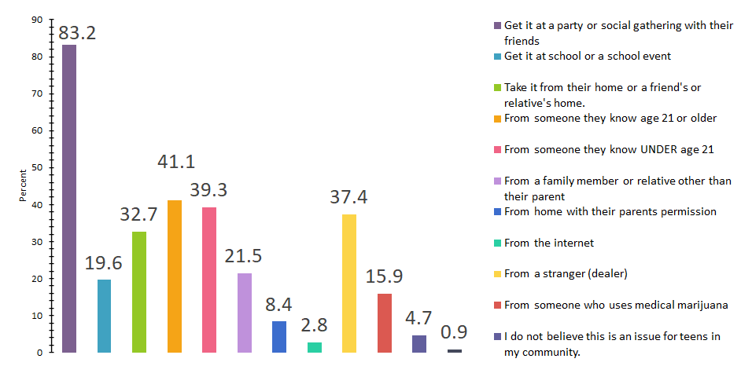
Parent Survey: In your community, what do you think are the most common ways that teenagers get marijuana? Select up to 3 responses.

Slide 44
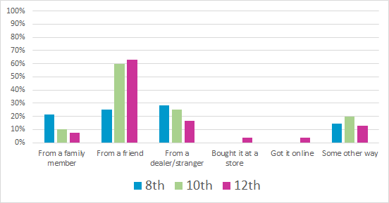
Where are students getting marijuana?

Slide 45
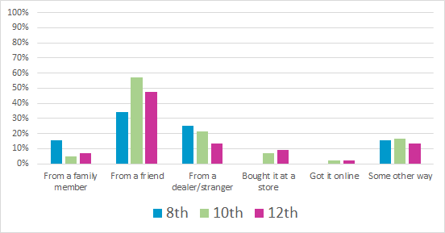
What the students say about where they get nicotine products

Slide 46
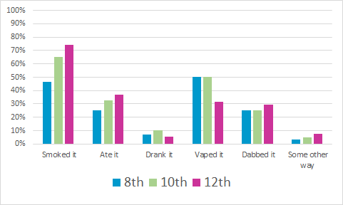
How are students using marijuana?

Slide 47
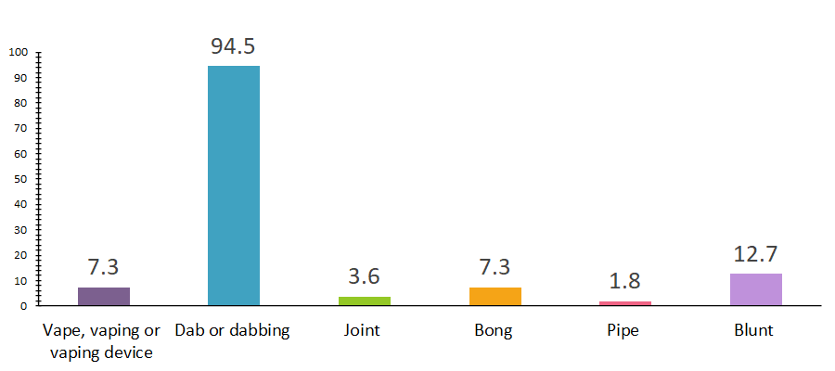
Parent Survey: In the previous question about ways that teens can use marijuana, are there methods or terms that were unclear to you or that you did not understand? (Check all that apply)
Reminder – About 30% of marijuana-using students dab!

Slide 48
Do Parents Approve of Marijuana Use?
No! Of the 126 students who did use marijuana in the past 30 days, 74% of them did so WITHOUT parent knowledge or permission
It was rare for parents to provide marijuana to teens; (5 students total)
But be aware - this also means that you might not know that your child is using marijuana.

Slide 49
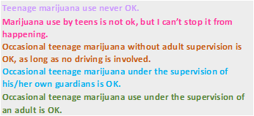
Parent survey : Which of the following statements represents your own beliefs about underage marijuana use?

Slide 50
Let’s look more closely at the story of prescription and illicit drug use

Slide 51
Please Note the Following Slides Use A Different Y-Axis

Slide 52
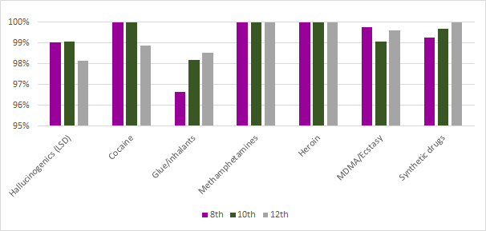
PNAS'21 Data Suggest More than 95% of Students DON'T Use Illicit Drugs

Slide 53
PNAS'21 Data Suggest More than 95% of Students DON'T Use Illicit Drugs

Slide 54
Select Student Populations

Slide 55
Please Note the Following Slides Use A Different Y-Axis

Slide 56
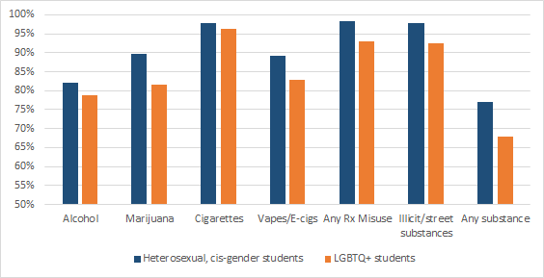
% of Students Not Using Substances in the Past 30 Days on PNAS'21, by Gender and Sexual Identity

Slide 57
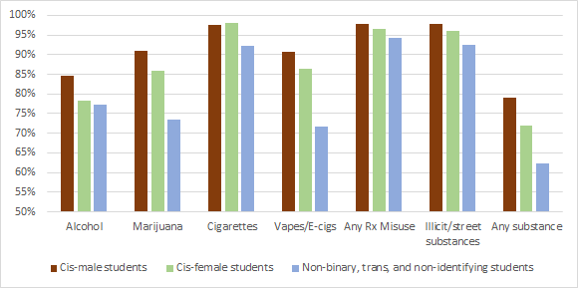
% of Students Not Using Substances in the Past 30 Days on PNAS'21, by Gender Identity

Slide 58
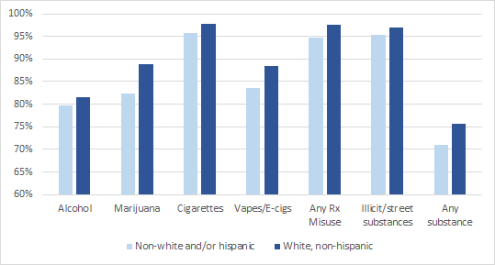
% of Students Not Using Substances in the Past 30 Days on PNAS'21, by Race/Ethnicity

Slide 59
Let’s look at driving statistics
Driving under the influence of alcohol
Driving under the influence of marijuana
Distracted driving
Parental Acceptance

Slide 60
Most Students Are Safe on the Road!

Slide 61
Almost 20 out of 20 students did not drink and drive (98%)

Slide 62
19 in 20 students who drove did not drive while using marijuana (96%)

Slide 63
17 in 20 students did not ride in a car with an alcohol intoxicated driver (87%)

Slide 64
18 in 20 students did not ride in a car with a driver using marijuana (89%)

Slide 65
16 out of 20 students did not use their phone and drive (83%)

Slide 66
Let’s look at Mental Health

Slide 67
Support Makes a Difference Increasing support across all domains was associated with LOWER (1) odds of depression and anxiety (2) odds of reporting suicidal ideation and self-harm (3) substance use in the 30 days prior to the survey!

Slide 68
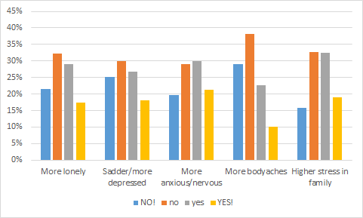
General Emotions During COVID-19

Slide 69
How supported do students feel by school staff?
Adult from school notices when you are doing a good job
Adult from school could help with personal problems
Adult from school talks to you one-on-one
73% AGREE
63% AGREE
60% AGREE
81% AGREE
Adult from school cares about you
83% AGREE
Adult from school could help with school problems
44% Agree with ALL of these!
7% Agree with NONE of these

Slide 70
How are students supported at home?
You have relatives in your life with whom you share your thoughts and feelings
94% AGREE
75% AGREE
You have relatives in your life that you enjoy spending time with
86% AGREE
You have a relative in your life that if you had a personal problem, you could you ask them for help
You have relatives in your life that you feel very close to
89% AGREE
71% Agree with ALL of these!
3% Agree with NONE of these

Slide 71
How well is school supported at home?
A relative in your life makes sure you do your homework and assignments
A relative in your life asks you about school
A relative in your life helps you with your homework and assignments
95% AGREE
85% AGREE
68% AGREE
Relative in your life knows if you were not home on time
91% AGREE
A relative in your life is aware if you attend your classes, either in person or online
88% AGREE
62% Agree with ALL of these!
2% Agree with NONE of these

Slide 72
Some Students Who Identify As LGBTQ+ May Need Additional Support
Students who self-identified as LGBTQ+ had significantly lower average support scores for the 2 relative support domains
These students were significantly more likely to disagree/strongly disagree with ALL of the following statements compared to students who do not identify as LGBTQ+ (7.3 vs 1.9%)
They had a relative at home...
That they felt close to
That they could share feelings with
That they enjoy spending time with
That they could go to for help with a problem

Slide 73
Some Students of Color May Need Additional Support
Students who self-identify as Hispanic and/or a non-white race had a significantly lower mean score on relatives' school support and relatives knowing their whereabouts
These students were more likely to disagree/strongly disagree with ALL of the following statements compared to white, non-Hispanic students (6.0 vs 1.1%)
They had a relative at home...
That asks you about school
That makes sure you do your homework and assignments
That helps you with your homework and assignments
That is aware if you attend your classes, either in person or online
That knows if you were not home on time

Slide 74
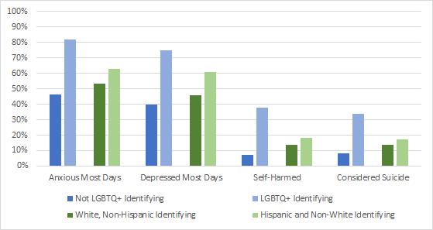
All Students, Esp. LGBTQ+ and Hispanic/Non-White, Need Mental Health Support

Slide 75
Less than 1 in 3 Students Meet Recommendation for 8+ Hours of Sleep

Slide 76
LGBTQ+ Students Report Fewer Hours of Sleep Compared to Non-LGBTQ+ Students

Slide 77
Hispanic and Non-White Students Report Fewer Hours of Sleep Than Non-Hispanic White Students

Slide 78
Relationship Health
Most teen relationships in the QH region have been healthy!
Students identifying as LGBTQ+, particularly those who are trans/non-binary/other may need more resources for establishing healthy relationships

Slide 79
What do students say about their friends' relationships?

Slide 80
Most Students Report That Their Friends Have NOT Been Abused by a Dating Partner

Slide 81
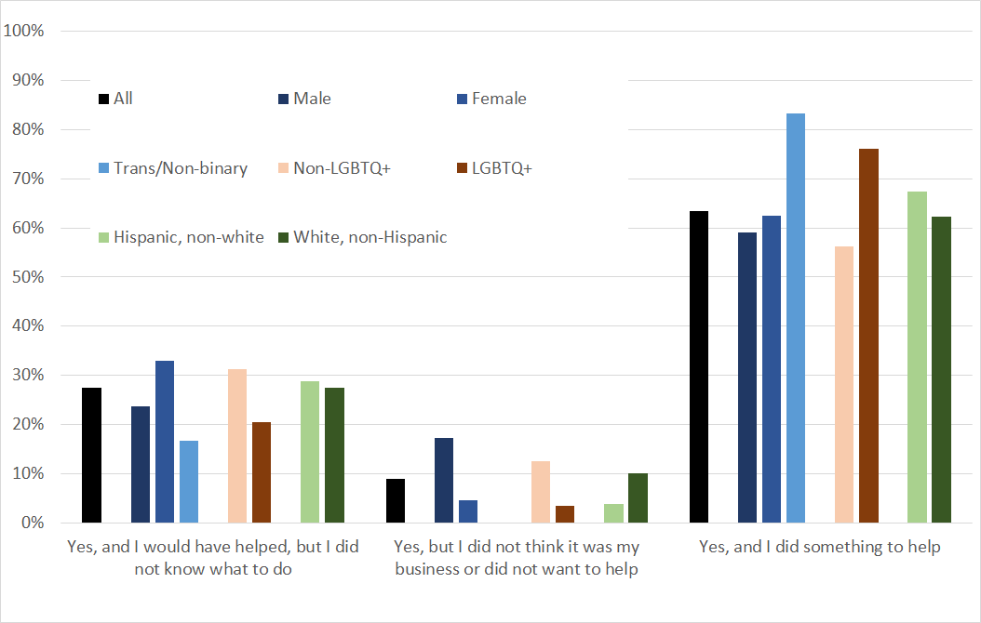
Students with abused friends provide help! Esp. LGBTQ+ and Trans/Non-binary Students

Slide 82
But students still need support creating healthy relationships

Slide 83
Who is at higher risk of unhealthy relationships?
Female students were 5-8x more likely to engage in unwanted sexual situations than male students
Trans/non-binary/other students were 8-10x more likely to engage in unwanted sexual situations than male students
LGBTQ+ students were 3-5x more likely to engage in unwanted sexual situations than male students

Slide 84
Who is at higher risk of unhealthy relationships?
LGBTQ+ students were more likely to report being afraid of their partners because of something their partner did or said as compared to non-LGBTQ+ students (28% vs 8%)
Trans/non-binary/other students and female students were more likely to report being called names as compared to male students (38% vs 20% vs 8%)

Slide 85
Who Do Students Talk to About Relationships and Dating Violence?

Slide 86
How will we use the data?
Educate Parents; School Staff; Students; Community Leaders; and Public Officials
Advocate for Effective Public Health & Prevention Policies
And much more!
Resource Development & Grant Writing
Promote the Positive Norm
Encourage Hope
Inform and Shape School and
Community Prevention Strategies

Slide 87
Questions? Comments?
Quaboag Hills Substance Use Alliance
www.QHSUA.org
Facebook/QHSUA
Gail Gramarossa, Prevention Director Nekr Jenkins, Project Director
ggramarossa@townofware.com njenkins@townofware.com
(413) 544-4386

Slide 92
Extra slides

Slide 93
Notable student differences in mental health
 | Worried I will get sick | Worried that friends/fam will get sick | More lonely | Sadder/more depressed | More anxious/ nervous | More body aches | Higher stress in family
LGBTQ+ students | HIGHER | Higher | HIGHER | HIGHER | HIGHER | HIGHER | HIGHER
Female students (v. male) | HIGHER | HIGHER | HIGHER | HIGHER | HIGHER | HIGHER | HIGHER
Hispanic/Non-white | -- | Slightly higher | Higher | Slightly higher | -- | -- | --

Slide 94
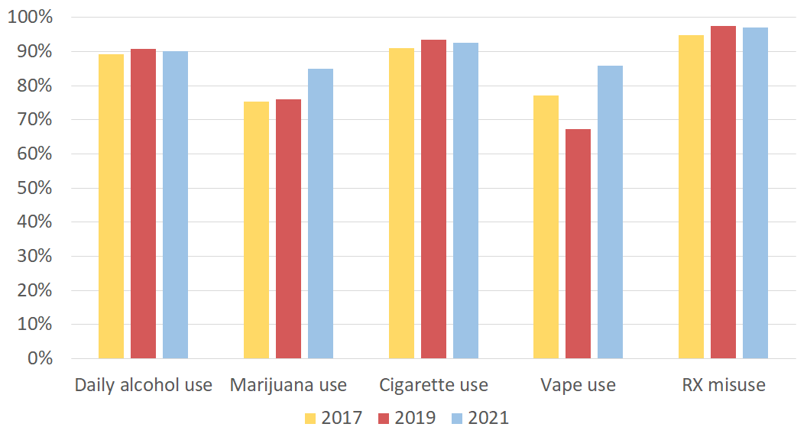
Percent of 8th Graders Who Report that Their Friends Think It's Somewhat Wrong or Very Wrong For Them To Use Substances (excludes Palmer)

Slide 95
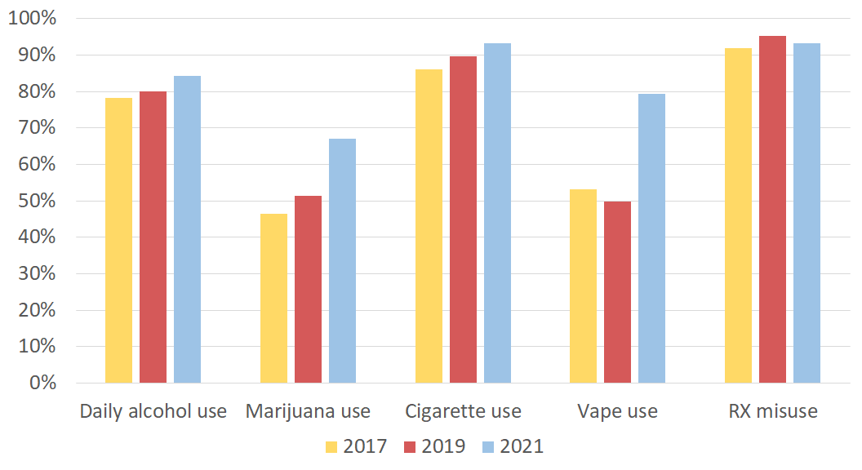
Percent of 10th Graders Who Report that Their Friends Think It's a Somewhat Wrong or Very Wrong For Them To Use Substances (Excludes Palmer)

Slide 96
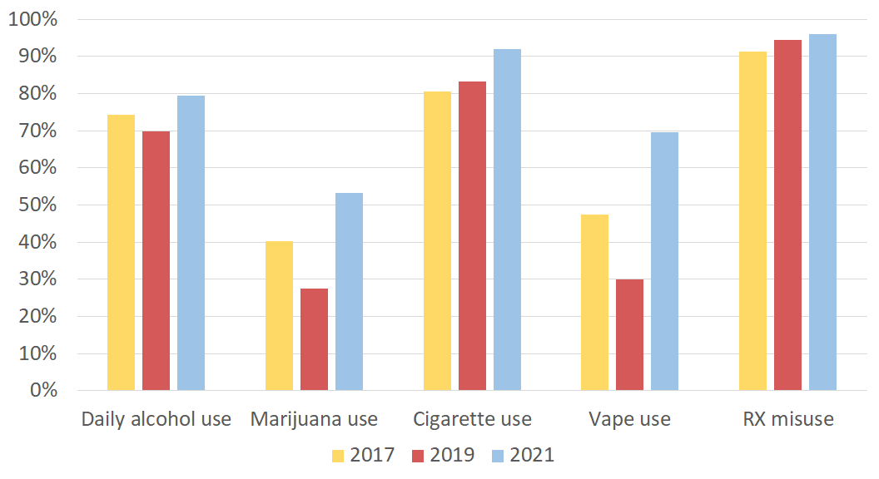
Percent of 12th Graders Who Report that Their Friends Think It's a Somewhat Wrong or Very Wrong For Them To Use Substances (Excludes Palmer and Quaboag)

Slide 97
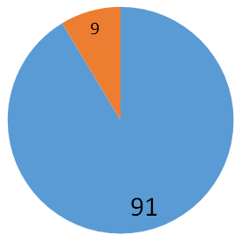
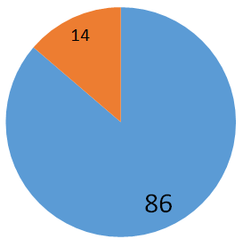
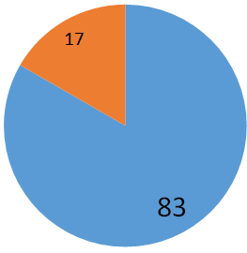
Most Students Did Not Vape in the Last 30 Days
(Entire cohort, no exclusions)
8th
Grade
10th
Grade
12th
Grade
2019 - 80% did NOT use
2019 - 72% did NOT use
2019 - 54% did NOT use
56% of students said it was moderate or very hard to get vapes in 2021 vs. 38% in 2019
Notes:
Question 51

Slide 98
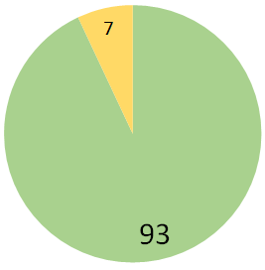
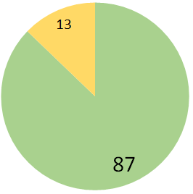
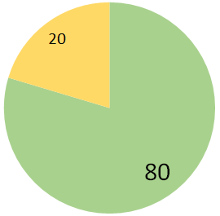
Most Students Did Not Use Marijuana in
the Last 30 Days
(Entire cohort, no exclusions)
8th
Grade
10th
Grade
12th
Grade
2019 - 89% did NOT use
2019 - 78% did NOT use
2019 - 62% did NOT use
56% of students said it was moderate or very hard to get vapes in 2021 vs. 38% in 2019
Notes:
Question 51

Slide 99
8th Graders Perceiving Substance Use as Moderate/Great Harm
Notes:
Binge drinking - How much do you think people risk harming themselves if they drink 5 or more drinks once or twice each week?

Slide 100
10th Graders Perceiving Substance Use as Moderate/Great Harm
Notes:
Binge drinking - How much do you think people risk harming themselves if they drink 5 or more drinks once or twice each week?

Slide 101
12th Graders Perceiving Substance Use as Moderate/Great Harm
Notes:
Binge drinking - How much do you think people risk harming themselves if they drink 5 or more drinks once or twice each week?

Slide 102
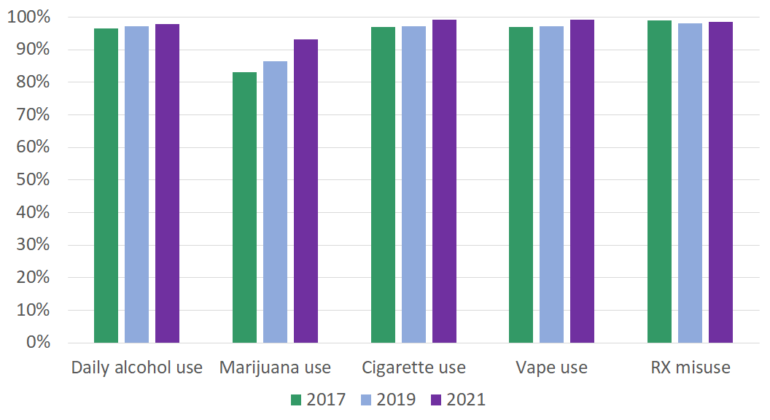
Percent of 12th Graders Who Report that Their Parents Think It's Somewhat Wrong or Very Wrong For Them To Use Substances

Slide 103
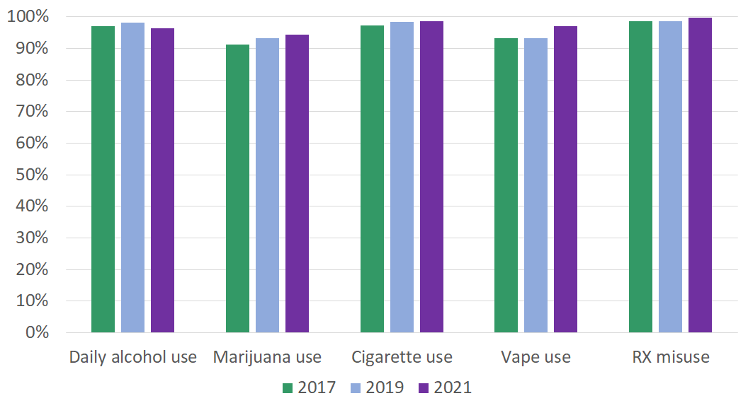
Percent of 8th Graders Who Report that Their Parents Think It's Somewhat Wrong or Very Wrong For Them To Use Substances

Slide 104
Percent of 10th Graders Who Report that Their Parents Think It's Somewhat Wrong or Very Wrong For Them To Use Substances

